Slide 1
CSE496 System Estimating Tomato Size on Branches in Greenhouses
CSE 496
Second Presentation
Emre YILMAZ
Project Supervisor: Prof. Dr. Yusuf Sinan Akgül
May 2024

Slide 2
Content
Project Scheme and Description
What Have Been Done So Far?
What To Do Next
Timeline
Resources

Slide 3
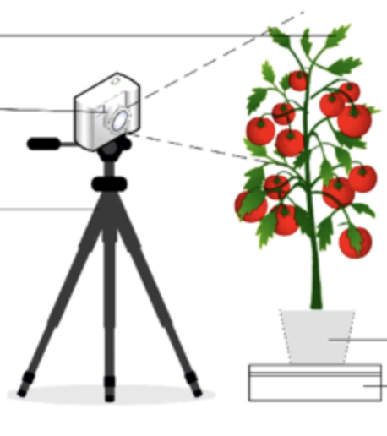
Project Scheme and Description
Monitoring the number of flowers on a plant provides valuable insights into its reproductive health and potential yield
Quantifying tomato yield allows farmers to assess the effectiveness of their cultivation practices and make informed decisions.
Monitoring changes in tomato size provides real-time feedback on plant growth and fruit development dynamics.
Model
*[1]
«3 tomatoes»
«3 flowers»
«12% size increase»

Slide 4
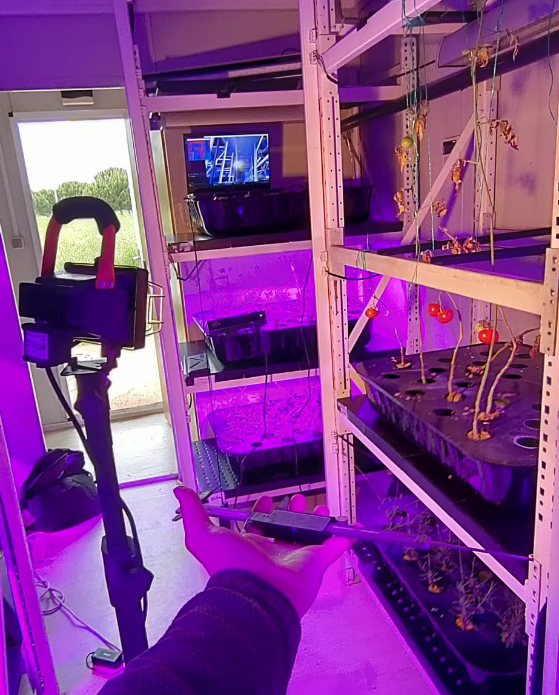
What Have Been Done So Far
The Intel RealSense camera was abandoned.
Work continued with the Xbox Kinect camera.
Visual data was collected through the Kinect camera in the greenhouse and measurements were taken by caliper.

Slide 5
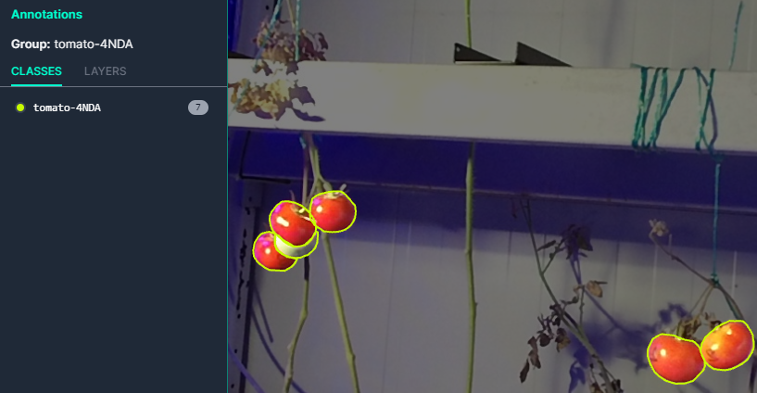
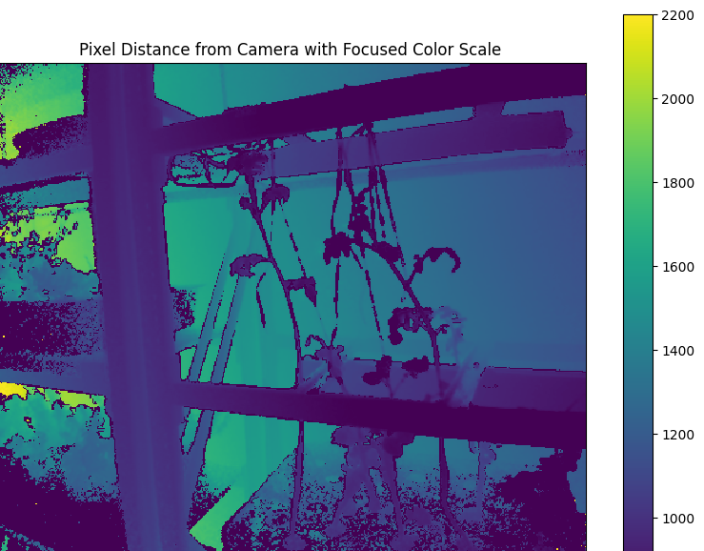
What Have Been Done So Far
Data that is collected from the greenhouse is segmented for use in my size estimation model.
Example output of Kinect camera is on the right.

Slide 6
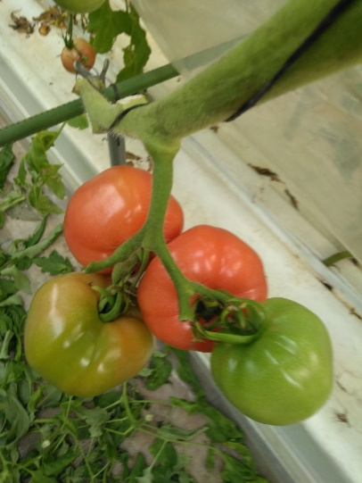
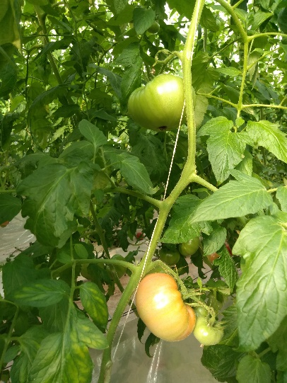
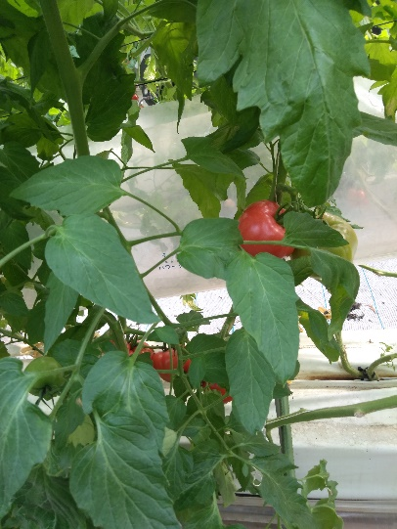
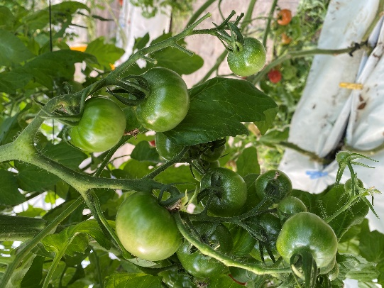
What Have Been Done So Far
In addition to using my own segmented data for size estimation, the project requires the ability to segment a tomato to meet its requirements. Regarding this task, the dataset created with data collected from external sources was trained with the YOLOv8 model. The results are as follows:

Slide 7
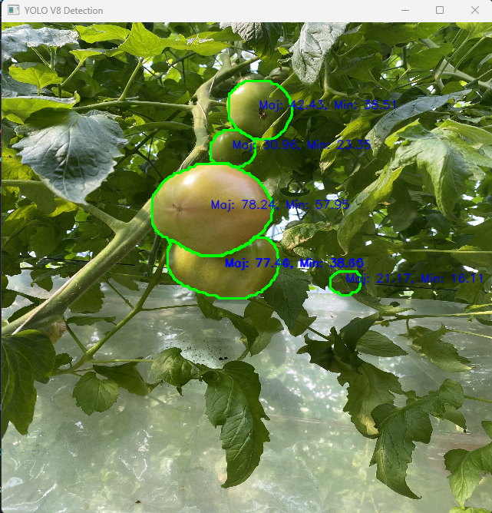
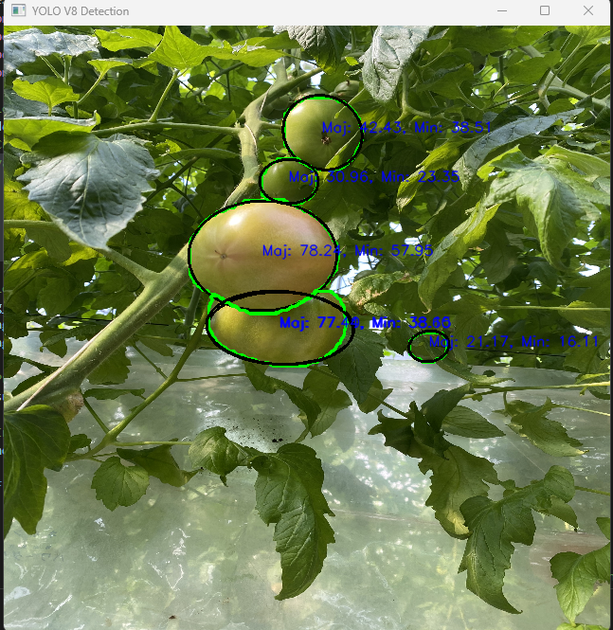
What Have Been Done So Far

Slide 8
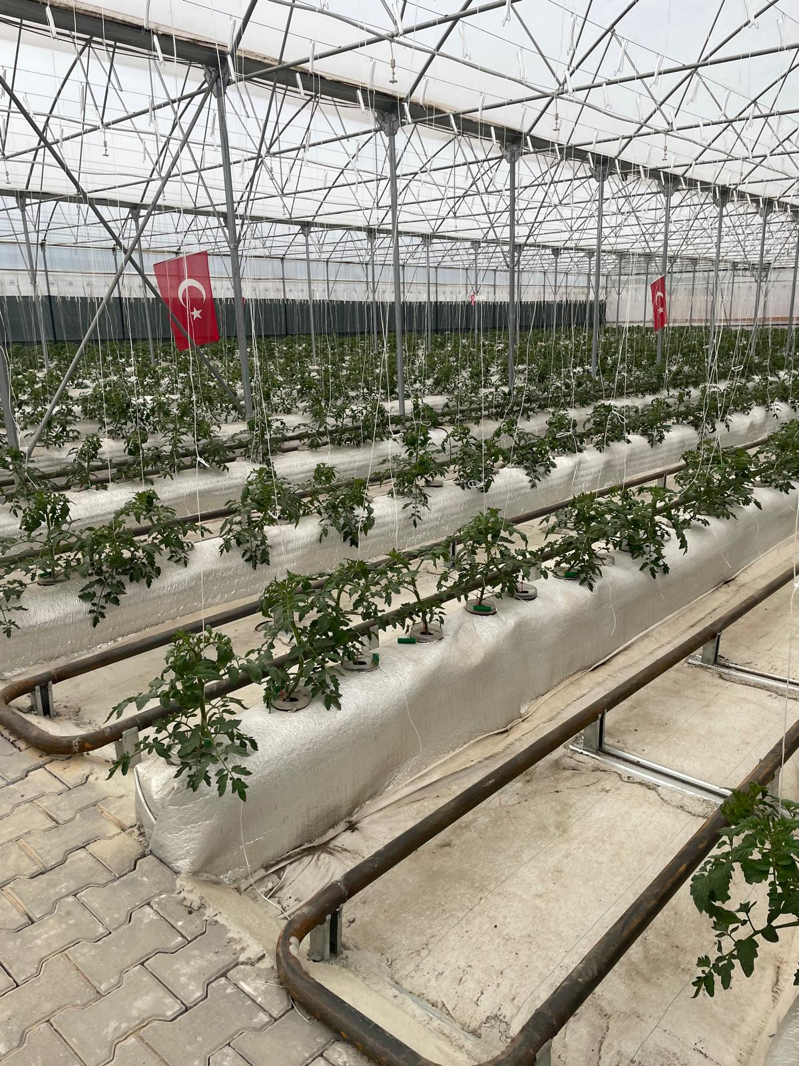
What to Do Next
Data will be collected from the greenhouse in Darıca.
The dataset will be enriched (both for size estimation and segmentation).
The tomato detection model will be improved.
Size estimation model will be developed.

Slide 9
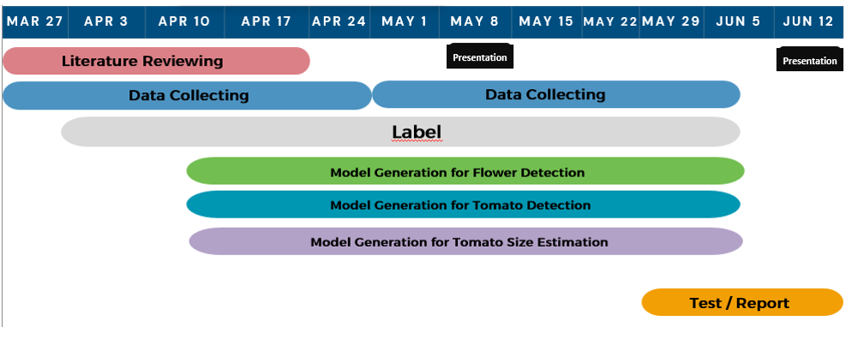
Timeline

Slide 10
References
[1]: Study on the detection of water status of tomato (Solanum lycopersicum L.) by multimodal deep learning)

